Slide 1
Front
Rear
5
3
2
7
70
40
50
10
15
50
40
5

Slide 2









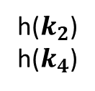


h($k_{3}$)
0
Universe
null
1
$$k_{12}$$
$$k_{1}$$
h($k_{2}$)
h($k_{4}$)
$$k_{2}$$
2
$$k_{6}$$
Keys
$$k_{3}$$
null
$$k_{4}$$
3
$$k_{42}$$
$$k_{5}$$
h($k_{4}$)
4
h($k_{5}$)
5

Slide 3
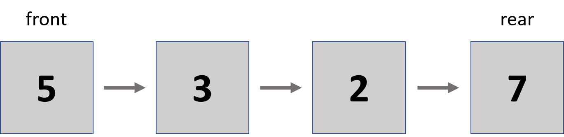

TAD Queue
Queue = { $\left\langle \left\langle e_{1},e_{2},e_{3},…,e_{n}\right\rangle ,front, back\right\rangle$ }
$$\{ inv: 0≤n∧Size\left(Queue\right)=n ∧\text{front}\text{ = }e_{1}∧\text{back}\text{ =} e_{n} \}$$
Queue :
Enqueue:
Dequeue:
Front:
IsEmpty:
CleanQueue:
---- Queue
Queue x Element Queue
Queue Element
Queue Element
Queue Boolean
Queue Queue

Slide 4
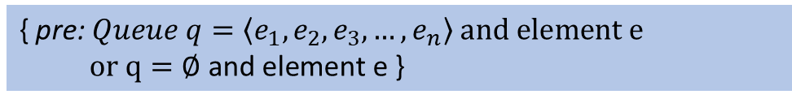
QueueConstructor()
Description: “Builds an empty queue”
{ pre: ― }
{ post: Queue q = ∅ }
Enqueue(queue, e)
Description: “Inserts a new element e to the back of the queue”
{ pre: $Queue q=\left\langle e_{1},e_{2},e_{3},…,e_{n}\right\rangle and element e$
$or q=\text{∅} \text{and} \text{element} \text{e}$ }
{ post: $Queue q=\left\langle e_{1},e_{2},e_{3},…,e_{n},e\right\rangle or q= \left\langle e\right\rangle$ }

Slide 5
Dequeue(queue)
Description: “Extracts the element in Queue queue’s front”
{ pre: $Queue q≠∅ i.e q=\left\langle e_{1},e_{2},e_{3},…,e_{n}\right\rangle$ }
{ post: $Queue q=\left\langle e_{2},e_{3},e_{4},…,e_{n}\right\rangle and element e_{1}$}
Front(queue)
Description: “Recovers the value of the element on the front of the queue.”
{ pre: $Queue q≠∅ i.e q=\left\langle e_{1},e_{2},e_{3},…,e_{n}\right\rangle$ }
{ post: $Element e_{1}$ }

Slide 6
IsEmpty(queue)
Description: “Determines if the Queue q is empty or not.”
{ pre: $Queue q$ }
{ post: $True if q=∅, False if q≠∅$ }

Slide 7
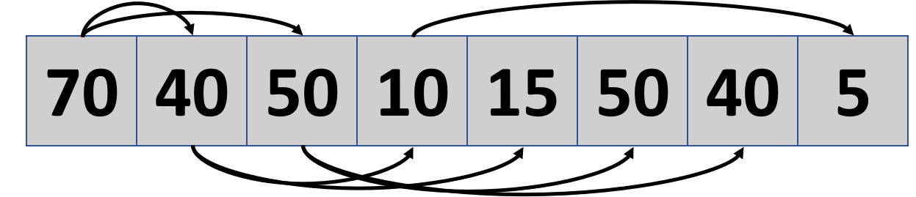
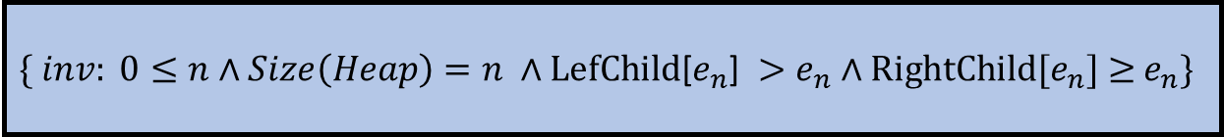
TAD MaxHeap
MaxHeap = { heapArray = [$e_{1},e_{2},e_{3},…,e_{n}$] }
$$\{ inv: 0≤n∧Size\left(Heap\right)=n ∧\text{LefChild}\text{[}e_{n}\text{]} >e_{n}∧\text{RightChild}\text{[}e_{n}\text{]} \text{≥} e_{n}\}$$
Heap:
Insert:
Peek
Remove
Size:
---- Heap
Heap x Element Heap
Heap Element
Heap Element
Heap Integer

Slide 8
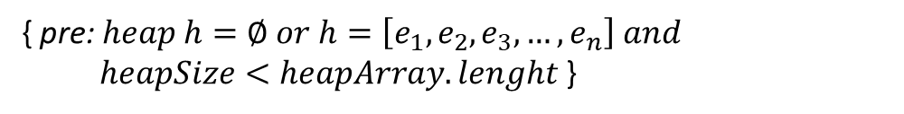

MaxHeapConstructor()
Description: “Builds an empty MaxHeap”
{ pre: ― }
{ post: $heap h=∅$}
Insert(heap, e)
Description: “Adds a new element to the heap and ensures that the heap property is maintained”
{ pre: $heap h=∅ or h=\left[e_{1},e_{2},e_{3},…,e_{n}\right] and$
$heapSize<heapArray.lenght$ }
{ post: $heap h =\left[e_{1},e_{2},e_{3},…,e_{n},e \right] and heapSize+1$ }

Slide 9
Peek(heap)
Description: “Returns the most prior element in the maxHeap”
{ pre: $heap h≠∅$ $i.e h=\left[e_{1},e_{2},e_{3},…,e_{n}\right]$ }
{ post: $e_{1}$ }
Remove(heap)
Description: “Remove the highest priority element, and then organizing the heap and returning the element”
{ pre $heap h≠∅$ $i.e h=\left[e_{1},e_{2},e_{3},…,e_{n}\right]$ }
{ post: $heap h =\left[e_{2},e_{3},e_{4},…,e_{n}\right] and e_{1}$ }

Slide 10
Size(heap)
Description: “Returns the size of maxHeap”
{ pre: $heap h≠∅$ $i.e h=\left[e_{1},e_{2},e_{3},…,e_{n}\right]$ }
{ post: heapSize }

Slide 11
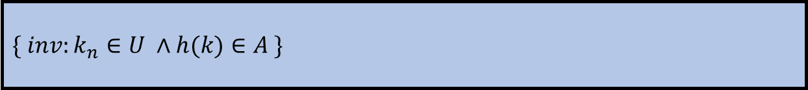




TAD HashTable
h($k_{3}$)
0
Universe
null
1
$$k_{12}$$
$$k_{1}$$
$$k_{2}$$
h($k_{2}$)
h($k_{4}$)
2
$$k_{6}$$
Keys
$$k_{3}$$
null
$$k_{4}$$
3
$$k_{42}$$
$$k_{5}$$
h($k_{4}$)
4
h($k_{5}$)
5
HashTable = { hashTable = [$\left\langle k_{1},v_{1}\right\rangle ,\left\langle k_{2},v_{2}\right\rangle ,\left\langle k_{3},v_{3}\right\rangle ,…,\left\langle k_{n},v_{n}\right\rangle$] }
$$\{ inv:k_{n}∈U ∧h(k)∈A \}$$
HashTable :
Insert:
Delete :
Search
HashTable
HashTable x Key x Value HashTable
HashTable x Key HashTable
HashTable x Key Value

Slide 12
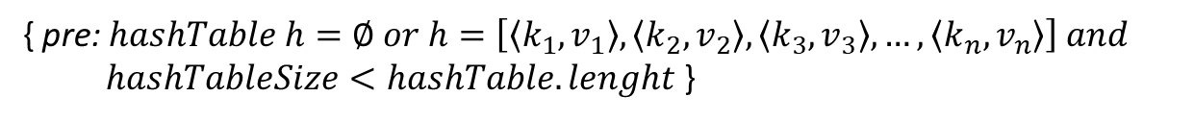
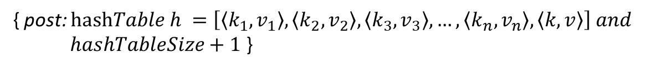
HashTable()
Description: “Builds an empty HashTable”
{ pre: ― }
{ post: $hashMap h= ∅$}
Insert(hashTable, k, v)
Description: “Adds a new element with value “V” and with its corresponding key “K” to the hashTable h”
{ pre: $hashTable h=∅ or h=\left[\left\langle k_{1},v_{1}\right\rangle ,\left\langle k_{2},v_{2}\right\rangle ,\left\langle k_{3},v_{3}\right\rangle ,…,\left\langle k_{n},v_{n}\right\rangle \right] and$
$hashTableSize<hashTable.lenght$ }
{ post: $\text{hash}Table h =\left[\left\langle k_{1},v_{1}\right\rangle ,\left\langle k_{2},v_{2}\right\rangle ,\left\langle k_{3},v_{3}\right\rangle ,…,\left\langle k_{n},v_{n}\right\rangle ,\left\langle k,v\right\rangle \right] and$
$hashTableSize+1$ }

Slide 13
Delete(hashTable, K)
Description: “search for the key in the hashTable and remove the value associated with that key”
{ pre: $\text{h}\text{ash}Table≠∅$}
{ post: $\text{hash}Table h =\left[\left\langle k_{2},v_{2}\right\rangle ,\left\langle k_{3},v_{3}\right\rangle ,…,\left\langle k_{n},v_{n}\right\rangle ,\left\langle k,v\right\rangle \right]$}
Search(hashTable, K)
Description: “search if the key is in the hashTable or not.”
{ pre: $\text{h}\text{ash}\text{Table} \text{h}≠∅$ }
{ post: Return the Object$if h\left(k\right)∈A, Return null if$ $h(k)∉A$}}

